Slide 1


WEBSITE FOR SUNGLASSES & GOGGLES
Name: M.Taha Usman
Roll no: 2024F-BSE-315
Section: C

Slide 2
Purpose of the Website
Main Purpose:
To showcase a wide range of stylish and functional sunglasses and goggles.
To educate visitors about the importance of eye protection and UV-blocking lenses.
To provide an online platform for exploring and buying eyewear.
Goals:
Attract potential customers with an appealing design.
Highlight the unique features of sunglasses and goggles.
Make it easy for users to find, compare, and inquire about products.

Slide 3
Website Structure
MAIN PAGE ( HOME PAGE ):
Welcome to Our Website
Introduction to Our Sunglasses and Goggles Website.

Slide 4
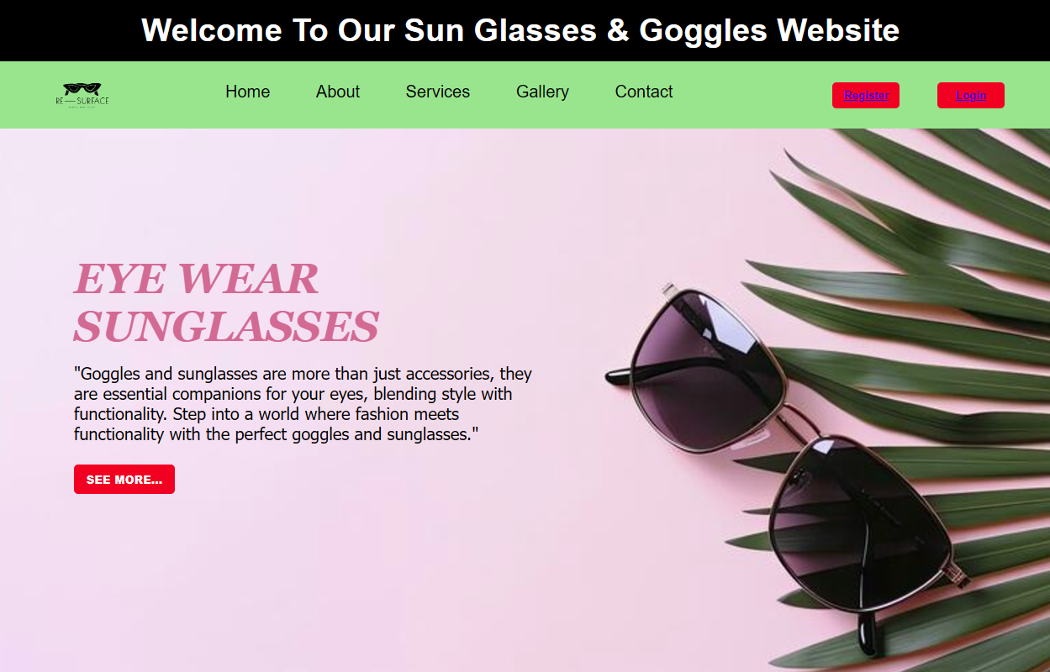

Slide 5
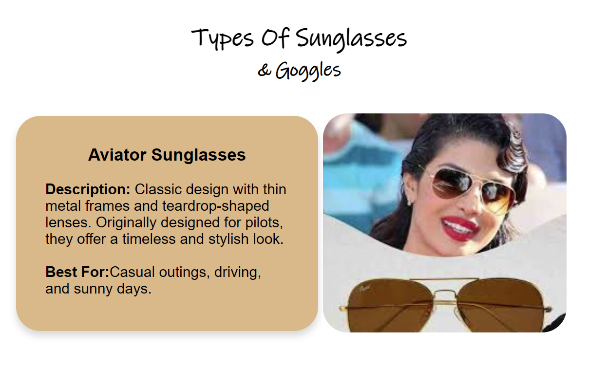

Slide 6
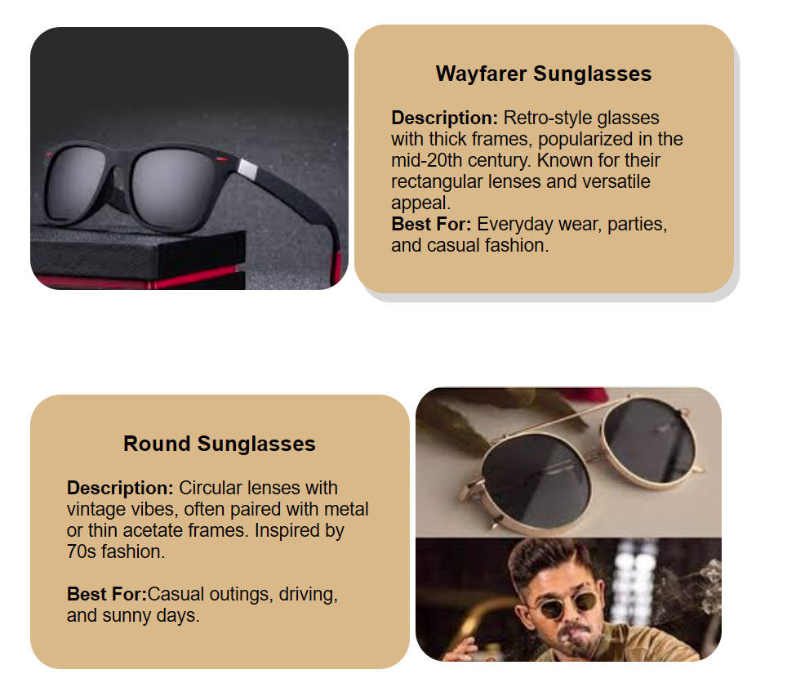

Slide 7
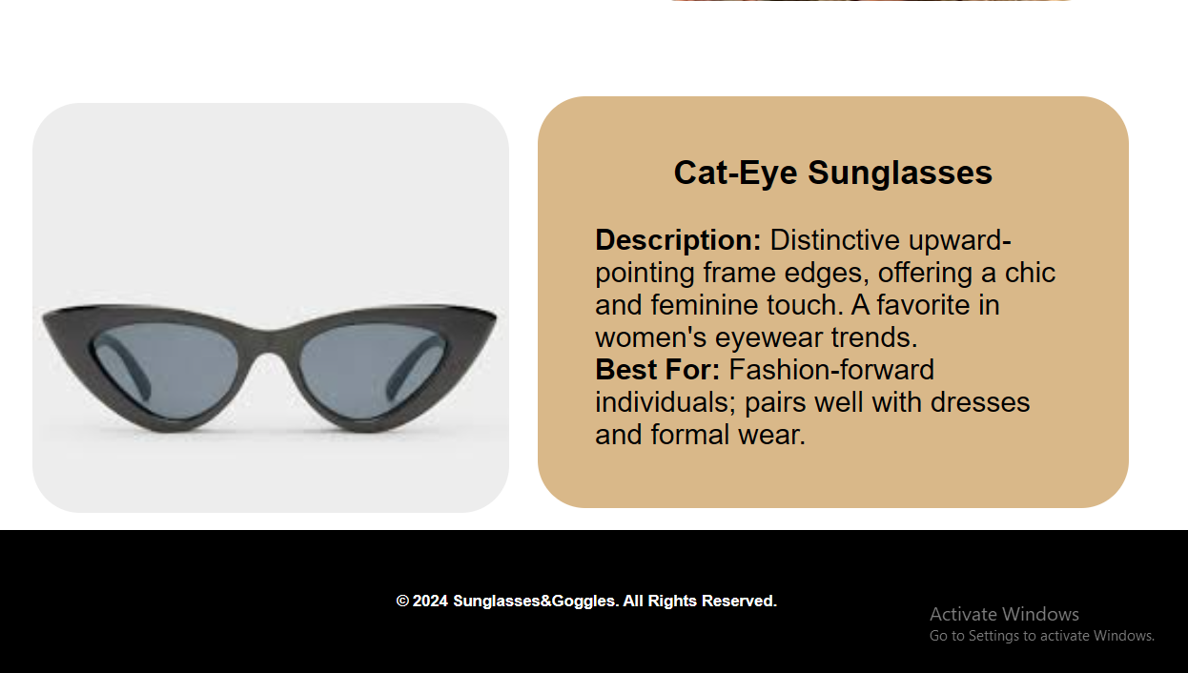

Slide 8
Website Structure
ABOUT PAGE:
Information about the company and its mission.
Why eye protection matters.

Slide 9
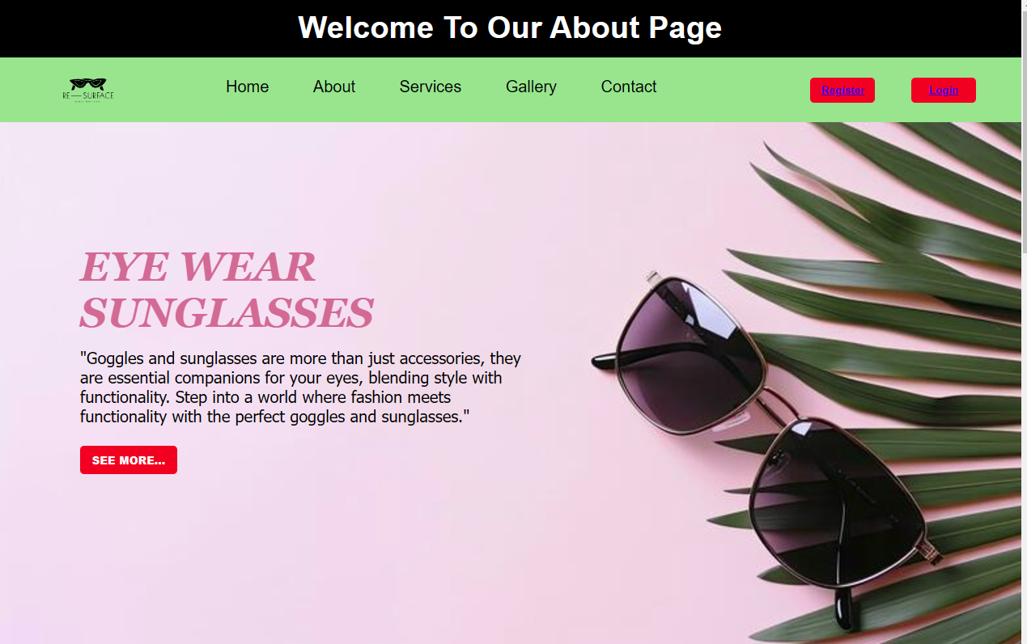

Slide 10
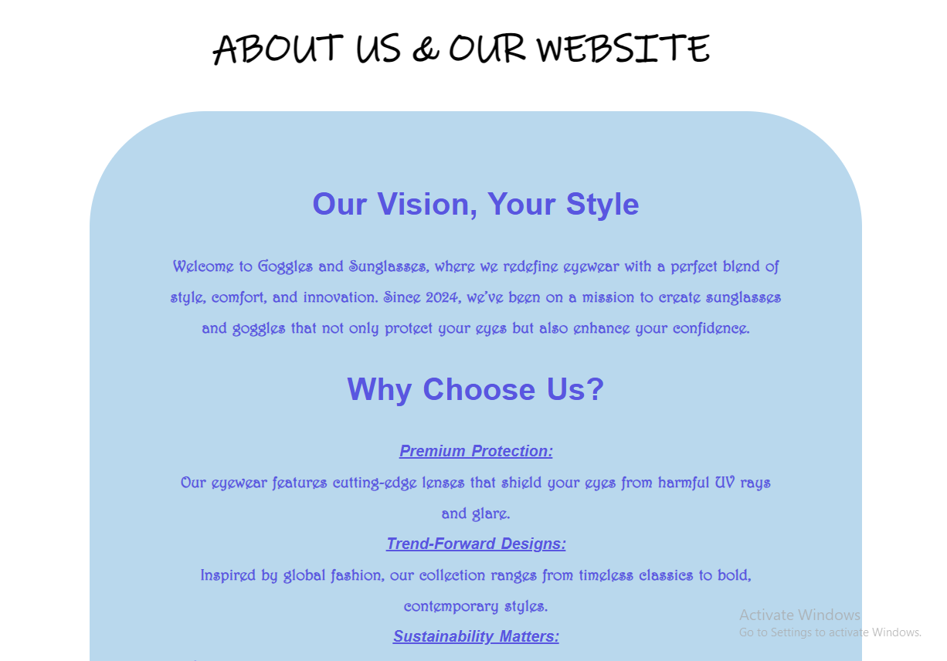

Slide 11
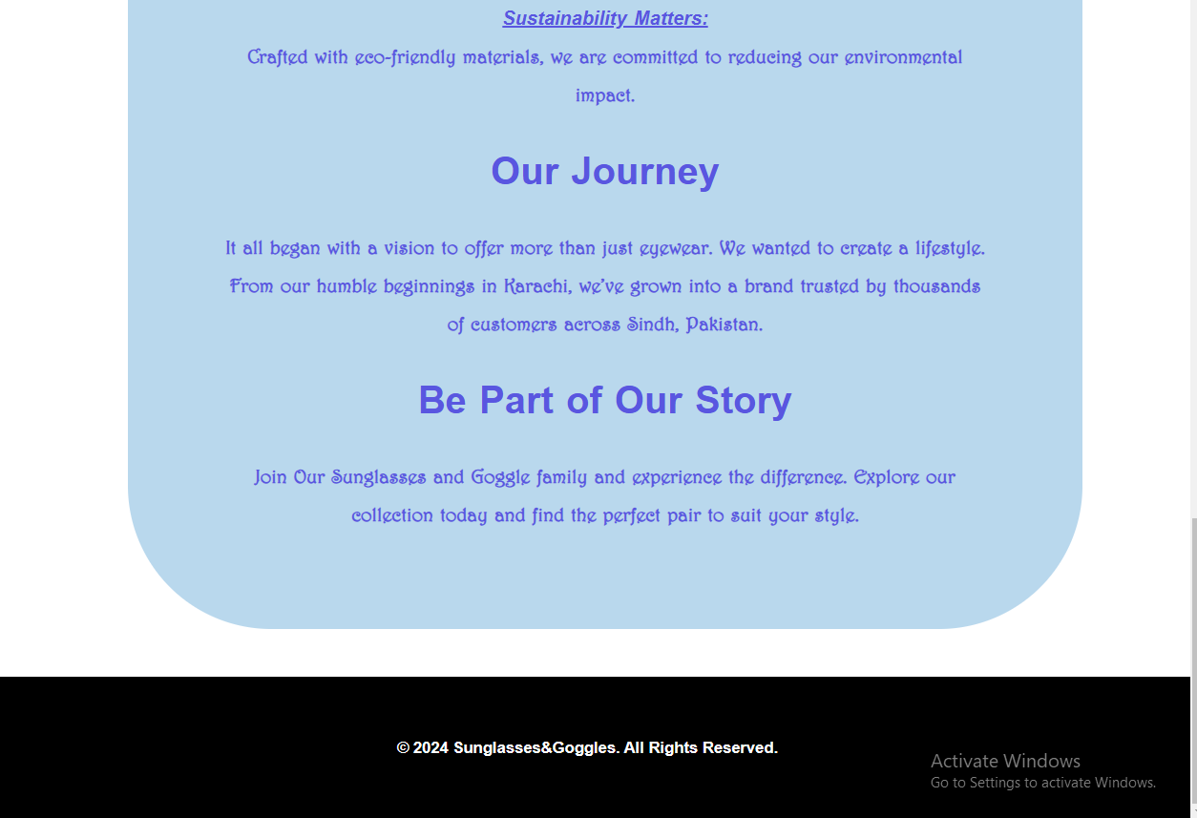

Slide 12
Website Structure
CONTACT PAGE:
Inquiry form or contact details.
Google Map Location Embed

Slide 13
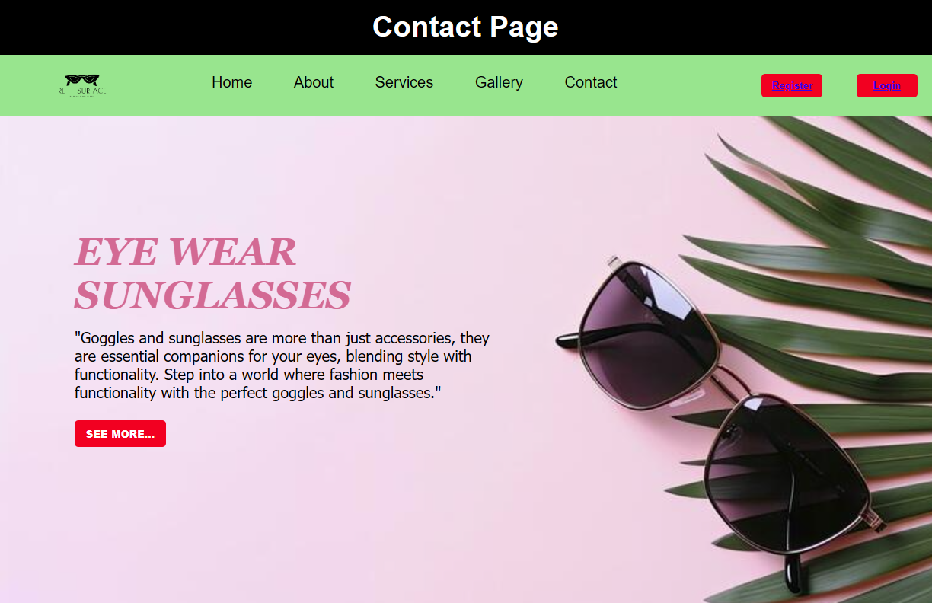

Slide 14
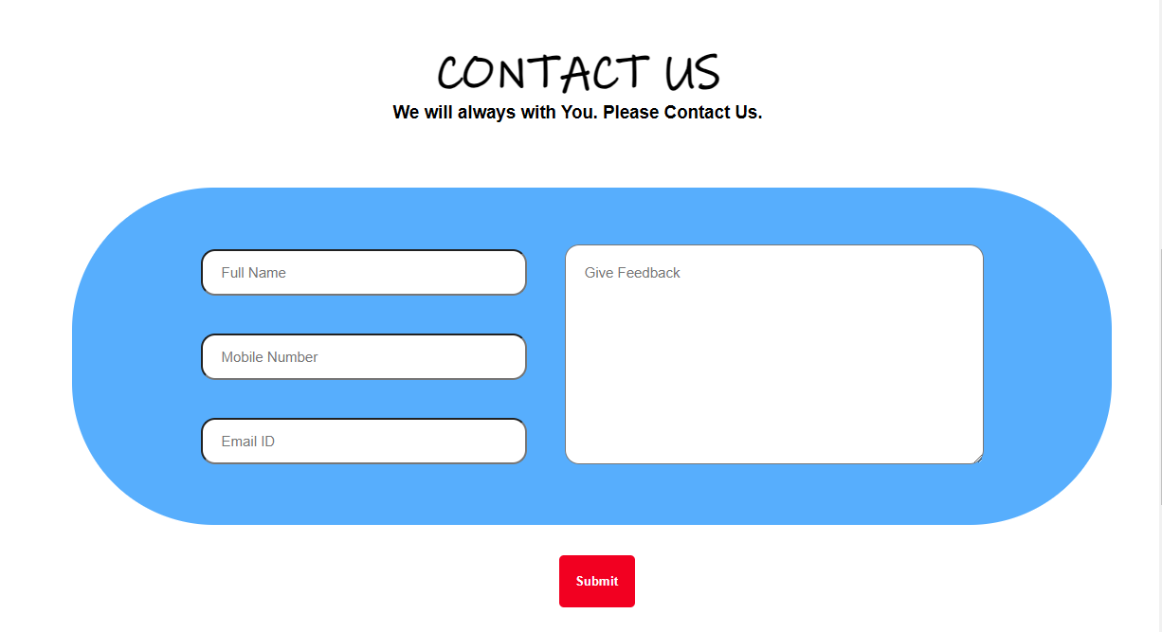

Slide 15
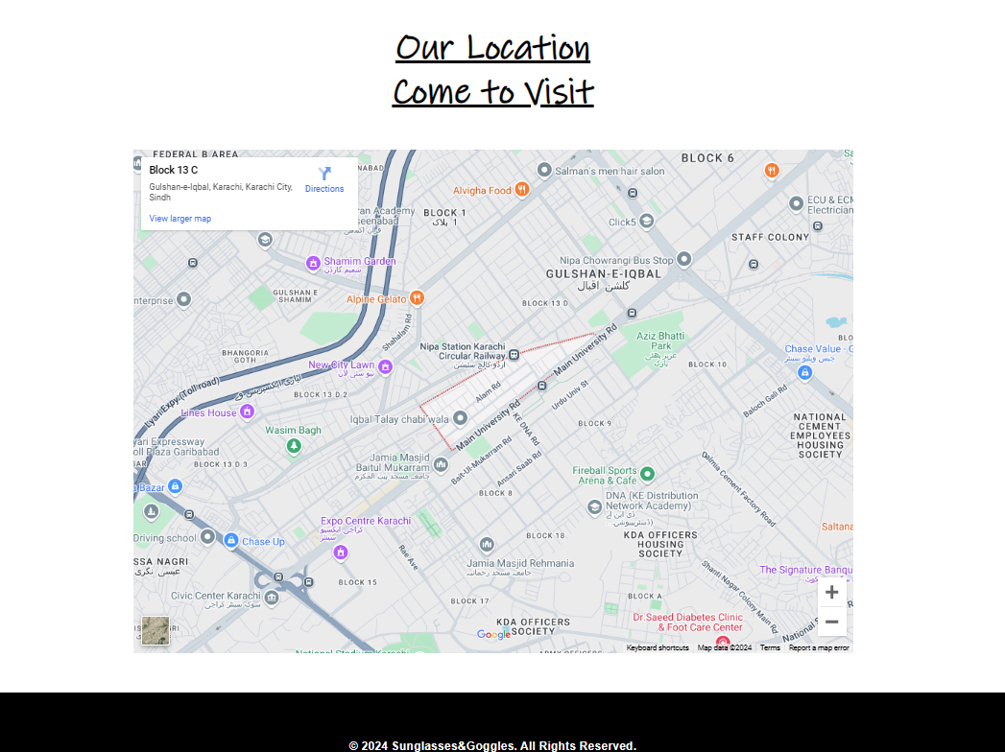

Slide 16
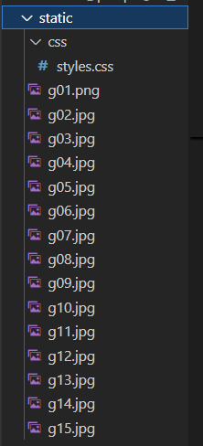
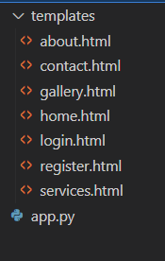
Folder Structure of Flask Project
STATIC FOLDER
TEMPLATES FOLDER

Slide 17
Work Flow of login and Registration system
Registration Workflow
User Input:
The user fills out the registration form, providing details like username, password, and email.
Validation:
The system validates the input fields (e.g., ensuring the password is strong, email format is correct, and all required fields are filled).
Temporary Data Storage:
The input data is stored in a Python dictionary (or any in-memory object) for the duration of the session.
Feedback:
Upon successful registration, the user is redirected to a success page or prompted to log in
Login Workflow
User Input:
The user enters their username and password into the login form.
Validation:
The system checks if the username and password match the simulated data stored in memory.
Authentication:
If the credentials match, the user is logged in and redirected to the dashboard or homepage.
If the credentials are incorrect, an error message is displayed.

Slide 18
Challenges faced & solutions implemented.
SOLUTION
Linked CSS using url_for.
Corrected route definitions.
Implemented validation logic.
Tested layouts in developer tools.
CHALLENGES
Fixed static folder structure.
Debugged using Flask’s Debug=True
Used in-memory storage (no database).
Added CSS media queries for mobile.

